Slide 1
Analyzing Evolution of “Sleeping Beauty” In Heterogeneous Citation Networks
Siddharth Shakya
Advisor : Dr. M. Narasimha Murty
M.E. Project
CSA – IISc

Slide 2
Outline
Objective
Identify Sleeping Beauties and study their evolution
Characterize the factors affecting its evolution
Our Work
Sleeping Beauty
Waking Period and Peaking Period of SB
Role of Influential Authors
Followership In Heterogeneous Citation Network

Slide 3
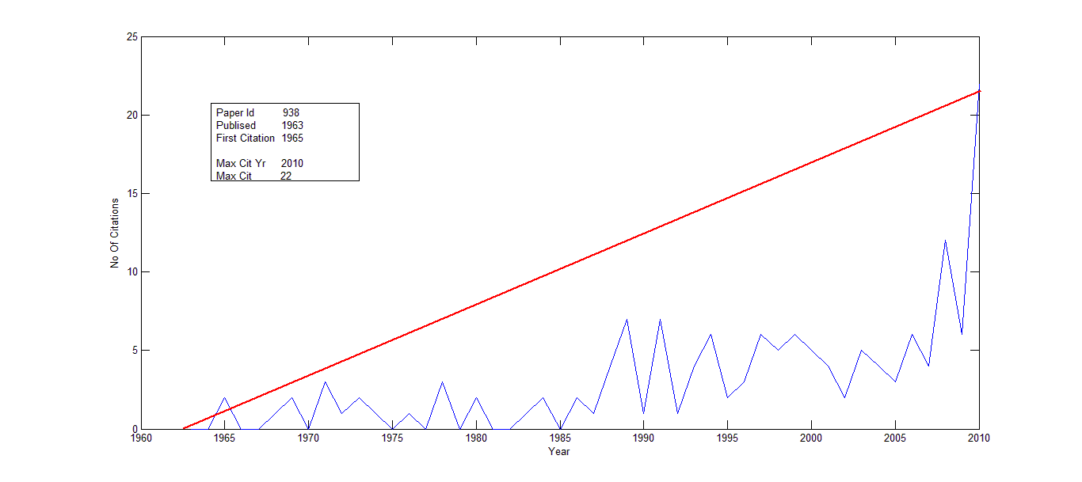
Citation Pattern of SB

Slide 4
Beauty Coefficient
Parameter Free Approach
Based on Citation History of paper
This tells how much a paper is sleeping beauty
Defining and identifying Sleeping Beauties in science Qing Ke et. al. Center for Complex Networks and Systems Research, School of Informatics and Computing, Indiana University, Bloomington, IN 47408

Slide 5
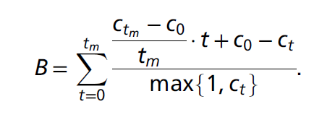
Defining and identifying Sleeping Beauties in science Qing Ke et. al. Proceedings of the National Academy of Sciences, page 201424329, 2015

Slide 6
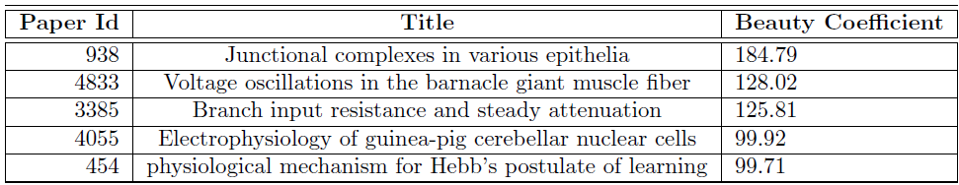
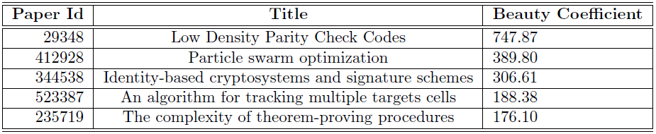
Sleeping Beauties
Pubmed
Microsoft Academic Network(CS Subset)

Slide 7
Role of Influential Authors

Slide 8
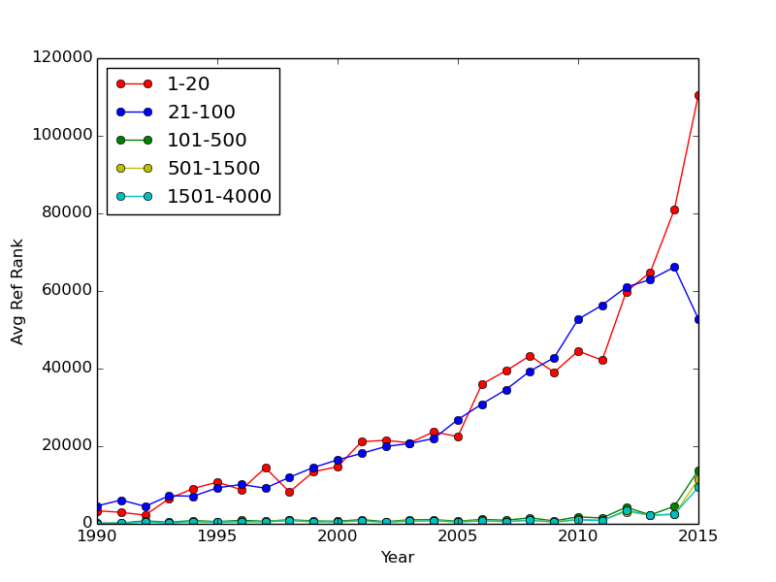
Average Rank of References

Slide 9
Rank Pattern Analysis
For each year of the citation history of SB, find the rank of authors citing the sleeping beauty paper
Take HIGHEST RANK for each year and plot on the graph
Rank is calculated using page rank

Slide 10
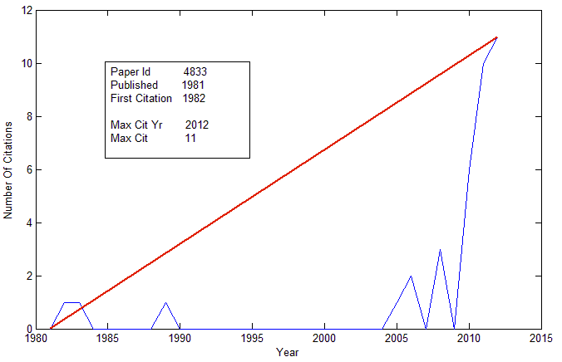
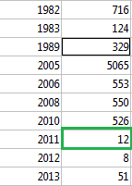
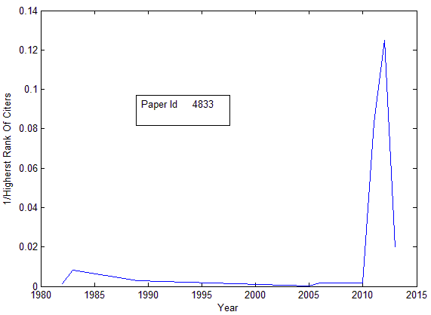
Voltage oscillations in the barnacle giant
muscle fiber
Year
Rank

Slide 11
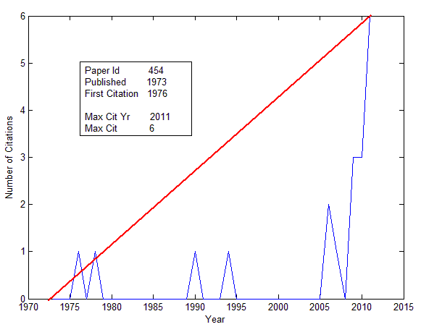
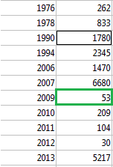
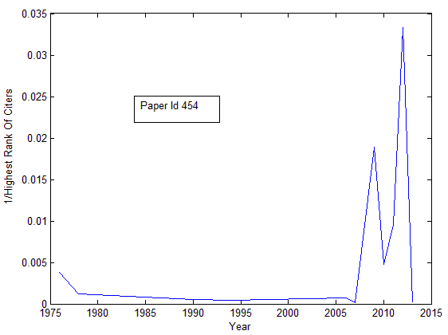
Citation Pattern
Physiological mechanism for Hebb's postulate of learning
Year
Rank
Rank Graph

Slide 12
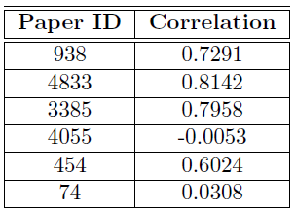
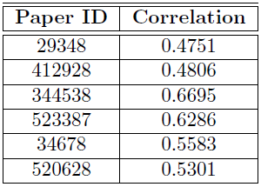
Correlation Coefficient of number of citation in year and Higest rank of citers
PUBMED CS MAG

Slide 13
Wakeup Point
Time when SB starts getting recognition after long time sleep
Importance of Wakeup Point
Can help us characterize the factors responsible for waking up of SB

Slide 14


Proposed Method
Defining and identifying Sleeping Beauties in science Qing Ke et. al. Center for Complex Networks and Systems Research, School of Informatics and Computing, Indiana University, Bloomington, IN 47408

Slide 15
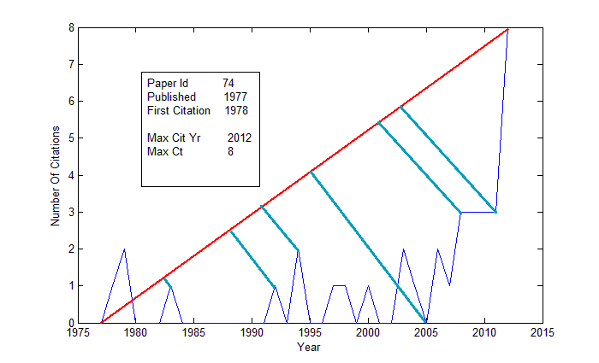

Slide 16
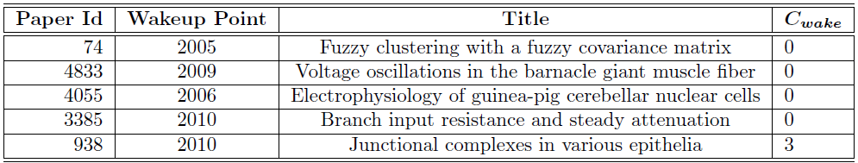
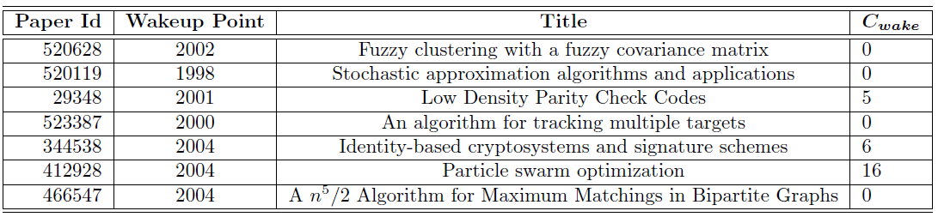
Discrepancies observed in proposed method
Paper has no citations in the year predicted as wakeup point
Pubmed
Microsoft Academic Network(CS Subset)

Slide 17
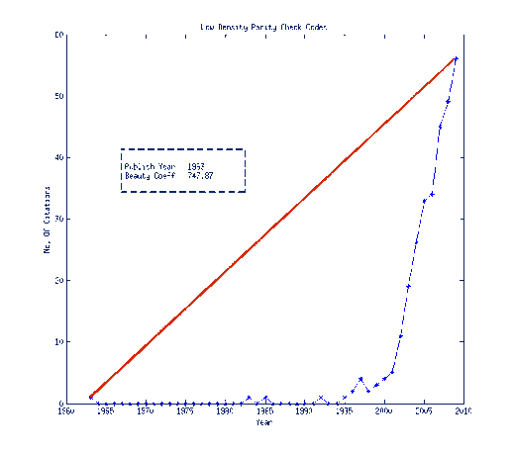
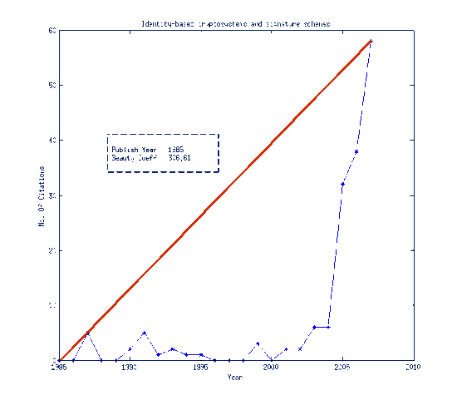
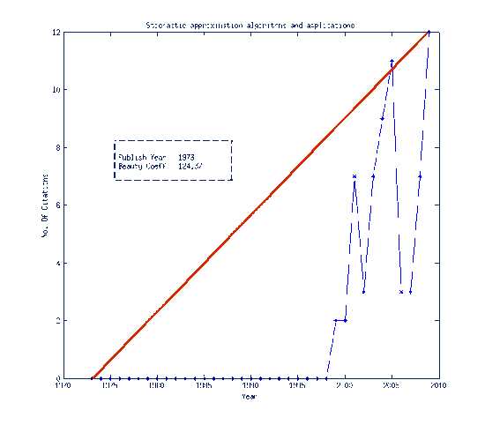
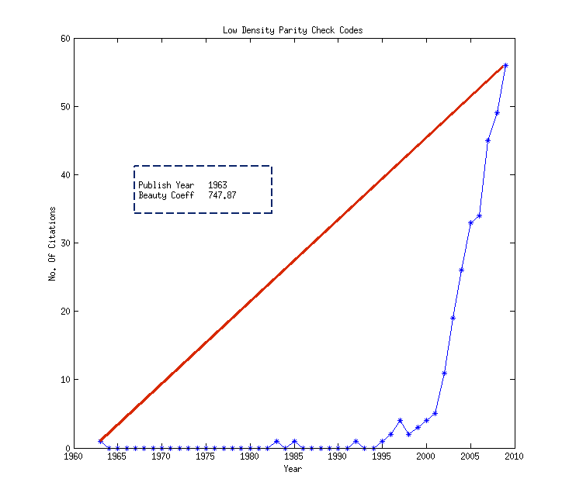
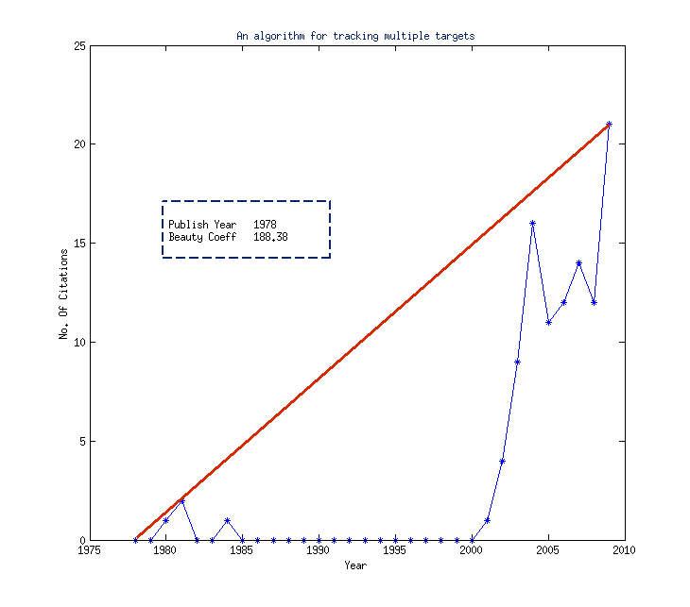
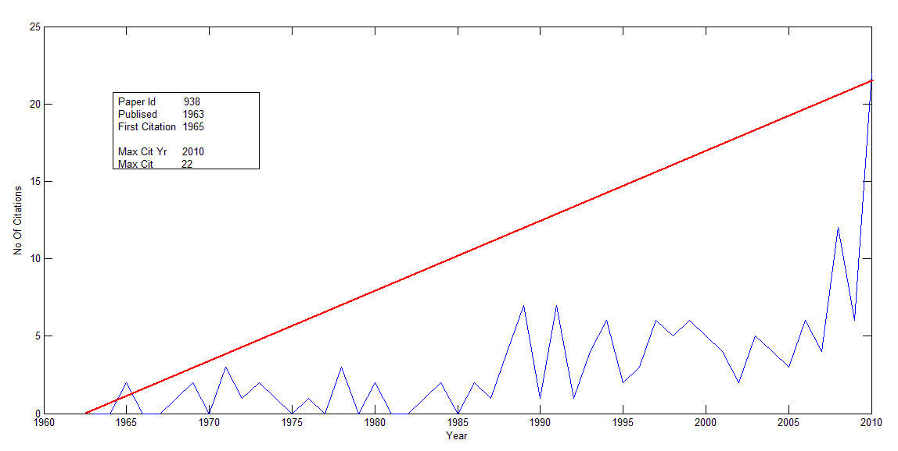

Slide 18
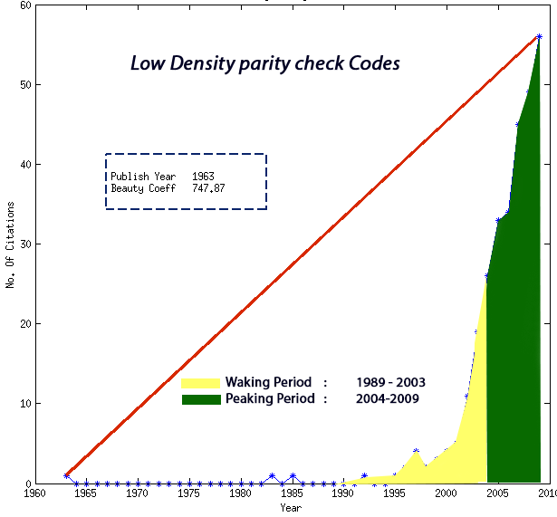
Waking Period and Peaking Period

Slide 19
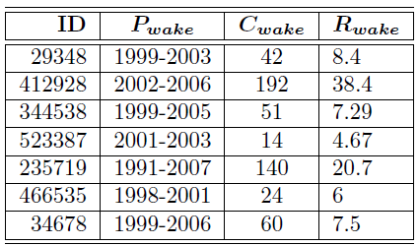
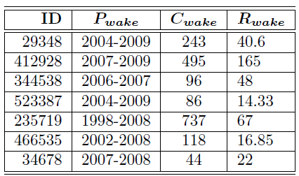
Citation and Rate of Citation for Microsoft Academic Network
Waking Period Peaking Period

Slide 20
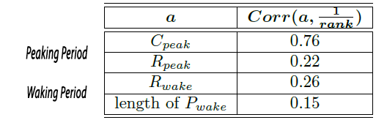
Correlation Between Author Rank and Citation Accumulated
In Peaking Period more influential is the citing author more is the number of citations accumulated

Slide 21
Followership In Heterogeneous Citation Network

Slide 22



3 Step Approach
Affinity Function,
Calculates tendency of one author following another author based on
Influence of authors in network given by Influence Function.
Some assumption about authors’ behavior
Behavior Function,
Calculates the strength of certain behavior of one author towards another author.
Assuming that this behavior indicates followership
Calculate Followership Score
Combine behavior strength weighted by Affinity function

Slide 23
Assumptions of Affinity Function
Followership is not a symmetric relation
Followership is not a Transitive relation
Followership is not exclusive
Two Influential authors are less likely to follow each other. (ego/competition)
Affinity of non influential author A towards influential author B is proportional to Influence(B)
Two non influential authors “DO NOT” follow each other

Slide 24
Affinity function considered
Two Authors are influential
Affinity is inversely related to their influence difference
Function considered
Affinity (A,B) = exp( -|Influential Authors|/abs( Rank(A)-Rank(B) ) )
Only one Author is influential
Affinity is proportional to Influence of influential author
Function Considered
Affinity (A,B) = Rank(B)/|Authors|

Slide 25

Behavior Considered
Copying Citations Of Followee
Based on Common Citation.
We only consider citations that are not frequently cited up to year t_a.
Ratio T1/T2 or exp(T1/T2)
T1 = How long paper ‘r’ was not cited by follower
T2 = In how much time follower cited ‘r’ after followee cited it
Citation Copying Probability
Percentage of Papers with rank better than ‘r’

Slide 26

Citation Copying Probability
Approach 1
Leader1
0.1
0.2
Fraction of Leader1’s references common with follower
Follower
Fraction of Leader2’s references common with follower
0.3
Leader2
0.1

Slide 27
Citation Copying Probability
Approach 2
Leader
Follower
Common References

Slide 28
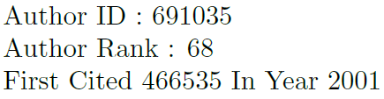
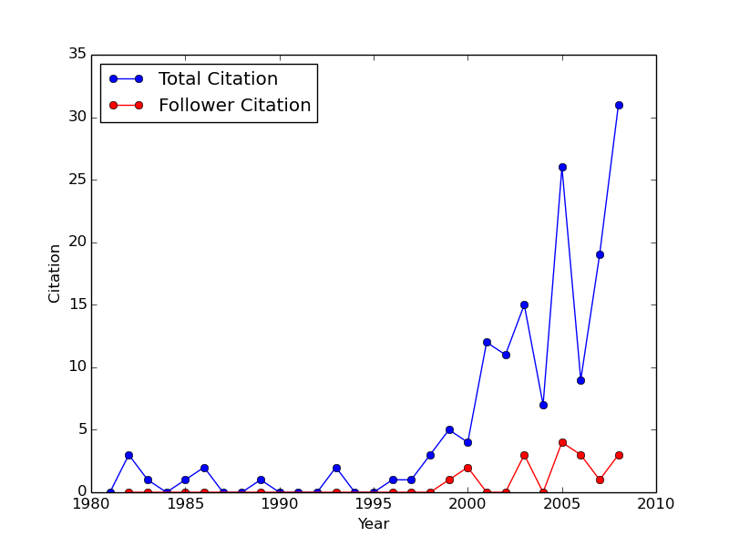
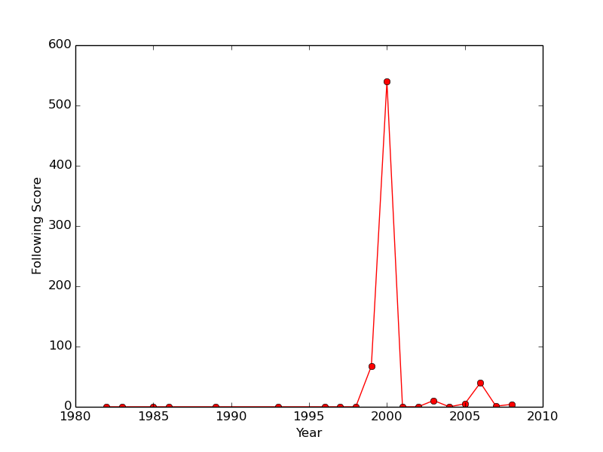

Slide 29
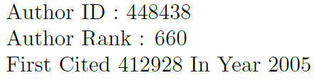
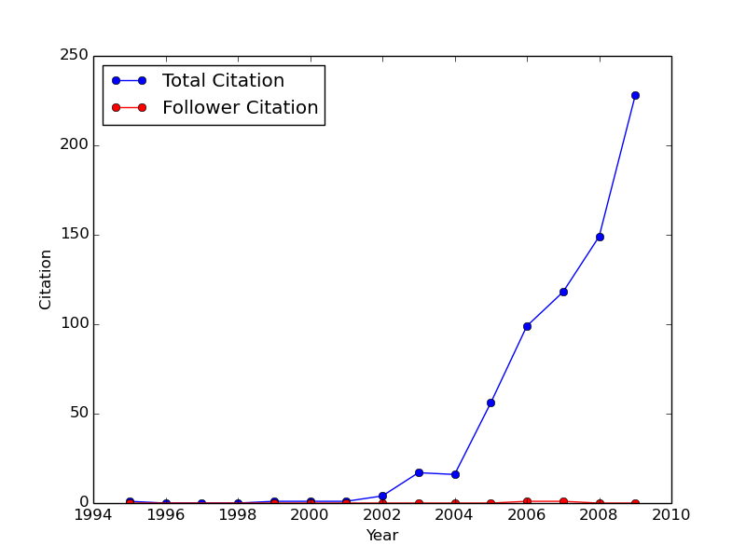
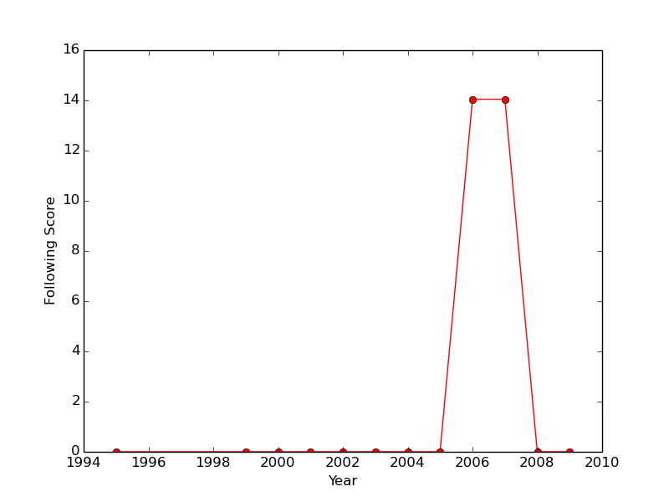

Slide 30

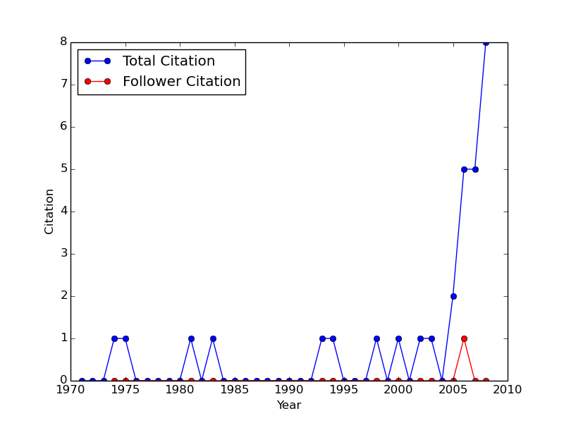
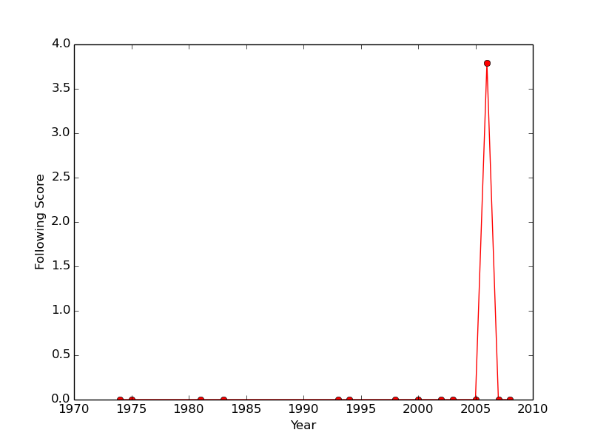

Slide 31
Conclusion
Influential Authors(computer science) also consider less popular papers for their research, hence are more likely to wake up a sleeping beauty
Citations of sleeping beauty increases in the vicinity of being cited by an influential author
Waking and Peaking period capture evolutionary changes of sleeping beauty better than wakeup point
Rank of the author doesn’t play any role in waking sleeping beauty.
In Peaking Period more influential is the citing author more is the number of citations accumulated
Followership as defined doesn’t play any role in the evolution of sleeping beauty

Slide 32
Future Work
Improve Following Coefficient
Find other factors that may effect the evolution of sleeping beauty
Extend the analysis to other popularity patterns e.g. Shooting Starts, Consistent Performers, Flash In The Pan

Slide 33
References:
Defining and identifying Sleeping Beauties in science
Qing Ke, Emilio Ferrara, Filippo Radicchi, and Alessandro Flammini1
Proceedings of the National Academy of Sciences, page 201424329, 2015
Premature Discovery or Delayed Recognition
Essays of an Information Scientist, Vol:4, p.488-493, 1979-80 Current Contents, #21, p.5-10, May 26, 1980
A review of theory and practice in scientometrics
John Mingers and Loet Leydesdor.
European Journal of Operational Research, 2015.
On the citation lifecycle of papers with delayed recognition.
Christian Lachance and Vincent Lariviere.
Journal of Informetrics, 8(4):863{872, 2014.
The pagerank citation ranking:bringing order to the web. 1999.
Lawrence Page, Sergey Brin, Rajeev Motwani, and Terry Winograd.
Essays of an Information Scientist:. E Garfield. 1979-1980.
Essays of an Information Scientist. ISI Press, 1977.

Slide 34
Thank You

